Slide 1
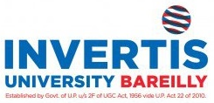
“AI-RESUME INTELLIGENCE HUB ”
A
Project Work Power Point Presentation
Submitted in partial fulfilment of the requirements for the degree of
BACHELOR OF TECHNOLOGY
In
COMPUTER SCIENCE & ENGINEERING
By
(Name: Shourya Saxena , Divyansh Singh , Saalim Yar Khan, Snehi Rastogi , Shivani & Abhinav Katheria)
(Student’s ID: BCS2022202,LBCS2023010, LBCS2023040, BCS2022130, LBCS2023008, & LBCS2023041 )
Under the Supervision of
Choudary Ravi Singh
(Assistant Professor/Associate Professor/Professor)
Computer Science & Engineering Department
Invertis University, Bareilly
To
Department of Computer Science & Engineering
Invertis University
Lucknow National Highway, NH-24, Bareilly, Uttar Pradesh - 243123
April- 2026

Slide 2

CONTENT
Abstract
Objectives
Motivation
Literature Survey (with merits and demerits)
Challenges
Requirements (Hardware and Software Requirements)
Flow Chart
Block Diagram
Tools & Technology Used
Project Methodology
Implementation (Project Work)
Testing
Applications
Conclusion and Future Scope
References

Slide 3
ABSTRACT
The AI-based Resume Screening Tool is designed to modernize and automate the recruitment process using advanced technologies such as Natural Language Processing (NLP) and Large Language Models (LLMs). In today’s competitive job market, organizations receive a large number of applications for a single position, making manual screening time-consuming and inefficient. This system addresses that challenge by automatically extracting key information from resumes, such as skills, education, and experience, and analyzing it in a structured manner.
The tool utilizes semantic similarity techniques, including Sentence Transformers, to compare resumes with job descriptions based on contextual meaning rather than simple keyword matching. This ensures more accurate candidate ranking and better alignment with job requirements. By reducing human intervention, the system minimizes bias, improves consistency, and significantly speeds up the hiring process, enabling recruiters to focus on decision-making rather than manual filtering.
In addition to screening, the system provides value-added features such as resume optimization and AI-driven mock interviews. Candidates receive constructive feedback to improve their resumes and interview performance. Overall, the tool benefits both recruiters and job seekers by creating a faster, fairer, and more efficient hiring ecosystem.

Slide 4
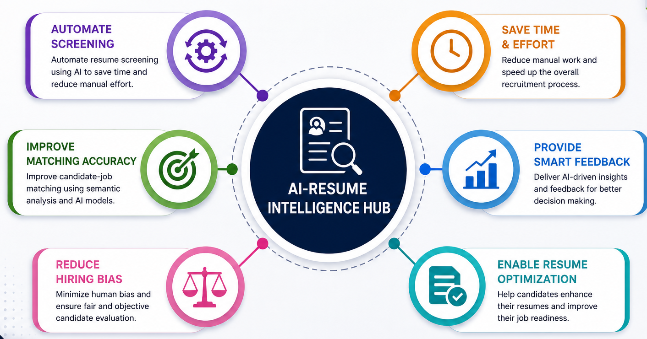
OBJECTIVES
Automate resume screening using AI
Improve candidate-job matching accuracy
Reduce human bias in recruitment
Save time and effort for recruiters
Provide intelligent feedback to candidates
Enable resume optimization and mock interviews

Slide 5
MOTIVATION
The motivation behind developing the AI-Resume Intelligence Hub arises from the growing challenges in modern recruitment systems. With organizations receiving hundreds of resumes for a single job opening, manual screening has become inefficient, time-consuming, and prone to human error. Recruiters often spend a significant portion of their time reviewing applications, which delays the hiring process and affects productivity. Additionally, traditional methods may overlook qualified candidates due to unconscious bias or reliance on keyword-based filtering systems that fail to capture the true potential of applicants.
This project is motivated by the need to create a smarter, faster, and more reliable solution for resume evaluation. By leveraging advanced technologies such as Natural Language Processing (NLP) and Large Language Models (LLMs), the system can analyze resumes based on context and meaning rather than simple keyword matching. This improves accuracy in candidate selection and ensures a fair and unbiased recruitment process. The integration of semantic analysis allows for better alignment between candidate skills and job requirements.
Furthermore, the system aims to empower candidates by providing intelligent feedback, resume optimization, and mock interview support. This not only enhances their job readiness but also bridges the gap between applicants and recruiters, creating a more efficient and transparent hiring ecosystem.

Slide 6
LITERATURE SURVEY
S. No. | Paper Title | Authors | Year | Method/Model Used | Key Findings | Limitations
1 | Applicant Tracking Systems | Cappelli | 2001 | Keyword Matching | Fast resume filtering | No semantic understanding
2 | NLP for Resume Parsing | Honnibal & Montani | 2017 | spaCy (NLP) | Extracts skills & entities | Limited context understanding
3 | BERT Model | Devlin et al. | 2018 | Transformer | High accuracy in text analysis | High computational cost
4 | Sentence-BERT | Reimers & Gurevych | 2019 | Semantic Similarity | Context-based matching | Needs training data
5 | AI in Recruitment | Various | 2020+ | Hybrid AI Models | Improves hiring efficiency | Lack of transparency

Slide 7
CHALLENGES
While the development of the AI-Resume Intelligence Hub offers many advantages, several challenges need to be considered:
1. Handling Unstructured Data: Resumes come in different formats and styles, making it difficult for the system to extract accurate and consistent information from all documents.
2. Accuracy of Semantic Analysis: AI models may sometimes misinterpret context or fail to fully understand the relevance of certain skills, leading to incorrect candidate evaluation.
3. Bias in AI Models: If the training data contains bias, the system may produce unfair results, affecting the neutrality and fairness of the recruitment process.
4. Technical Limitations: The system depends on advanced technologies like NLP and LLMs, which require high computational power, proper configuration, and stable performance.
5. Data Privacy and Security: Handling sensitive candidate information raises concerns about data protection, requiring strong security measures to prevent misuse or breaches.
6. High Development and Maintenance Cost: Building and maintaining such an AI system requires skilled professionals, continuous updates, and significant computational resources.

Slide 8
REQUIREMENTS
SOFTWARE REQUIREMENTS
Operating System: Windows 10/11, macOS, or Linux
Programming Language: Python (preferred for AI & Machine Learning development)
Libraries & Frameworks: spaCy (for NLP processing) Sentence Transformers (for semantic similarity) LangChain (for LLM integration) PyPDF (for resume parsing) Scikit-learn (for machine learning utilities)
Development Tools: VS Code / PyCharm / Jupyter Notebook
Database (Optional): MySQL / SQLite (for storing user data and results)
Web/Interface (if applicable): Streamlit (for frontend interface) Flask / Django (for backend development
HARDWARE REQUIREMENTS
Processor: Intel i5 or higher (recommended for smooth AI processing)
RAM: Minimum 8GB RAM (16GB recommended for better performance)
Storage: Minimum 256GB SSD (for faster data access and system speed)
Input Devices: Keyboard and mouse for user interaction
Output Devices: Monitor/display for visualization of results and interface
Internet Connectivity: Stable internet connection for API access, model updates, and deployment

Slide 9
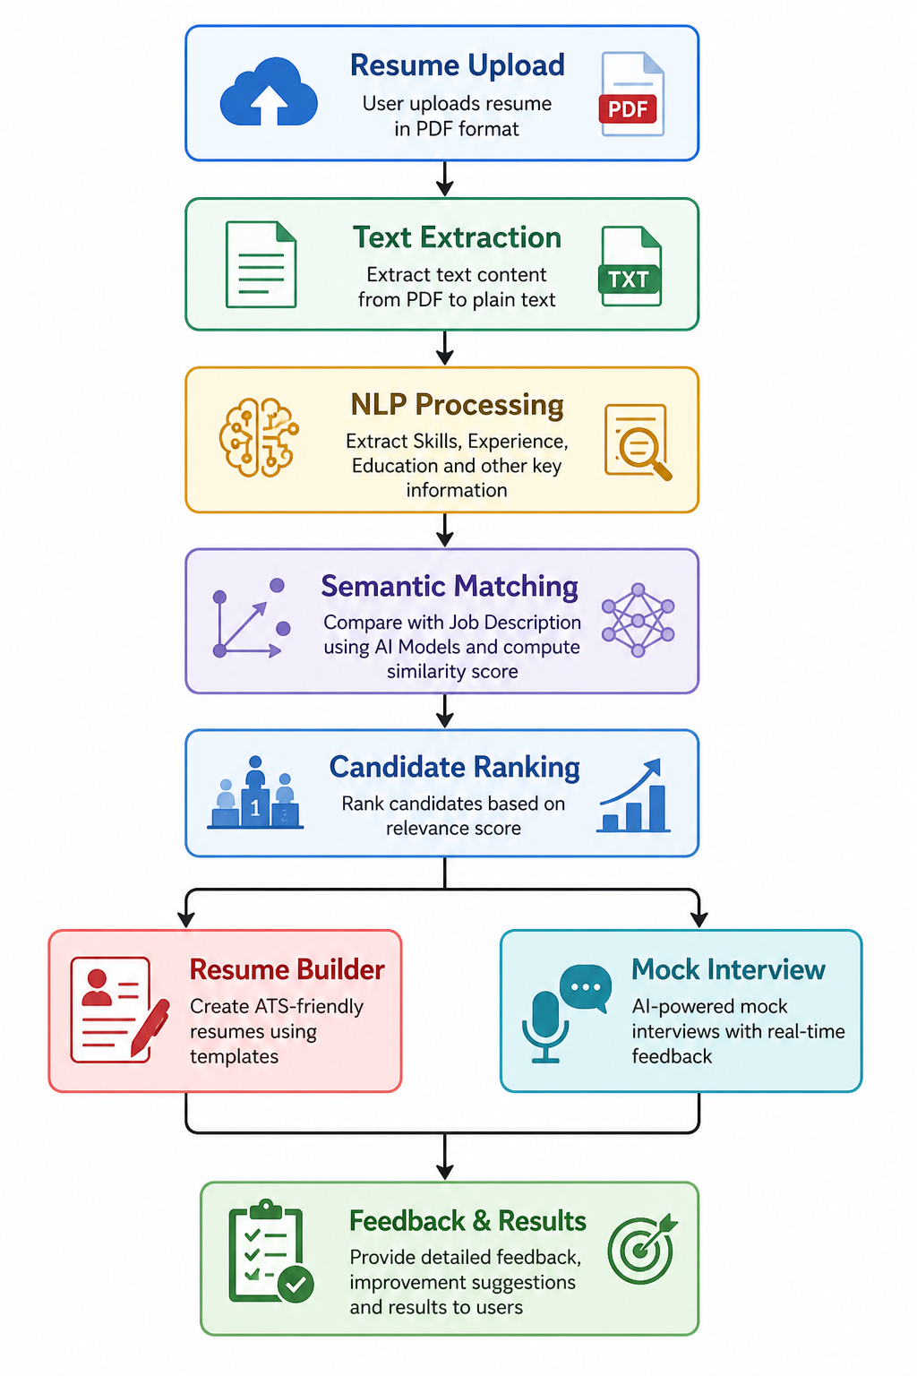
Flow Chart

Slide 10
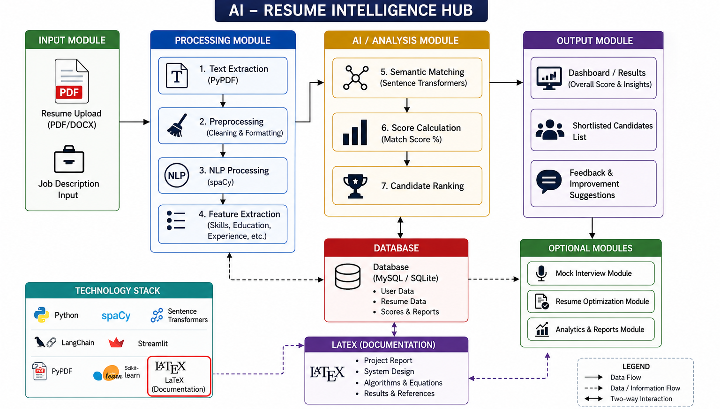
BLOCK DIAGRAM

Slide 11
TOOLS & TECHNOLOGY USED
Programming & Core Technology
Python: Used as the primary programming language for backend development and AI implementation.
Libraries & Frameworks
spaCy : For Natural Language Processing and text analysis.
Sentence Transformers : For semantic similarity and candidate-job matching.
LangChain : For integration with Large Language Models (LLMs).
Scikit-learn : For machine learning utilities and evaluation.
PyPDF : For extracting text from resume files.
Frontend & Backend
Streamlit : For building interactive user interface.
Flask :For backend development (if required).
Database
MySQL / SQLite: For storing user data, resumes, and results.
Deployment Tools
Docker: For containerization and scalable deployment.
Documentation
LaTeX: For generating professional reports and formatted resumes.

Slide 12
PROJECT METHODLOGY
The AI-Resume Intelligence Hub is developed using an Agile Methodology with an Iterative approach to ensure flexibility, continuous improvement, and efficient development.
1. Requirement Analysis
Identify user needs, project goals, and system requirements.
2. System Design
Design architecture, flowcharts, and user interface of the system.
3. Development
Implement modules such as resume parsing, NLP processing, and semantic matching using AI models.
4. Testing
Perform unit testing, integration testing, and system testing to ensure accuracy and performance.
5. Iteration & Improvement
Continuously improve the system based on feedback and testing results.
6. Deployment
Deploy the application using Docker for scalability and easy maintenance.

Slide 13
IMPLEMENTATION
Describe your project’s work very clearly using screenshots of your project. Highly emphasise on this section and you may choose number of ppt slides for the same as per your needs. //10 to 15 ppt slides

Slide 14
TESTING
The AI-Resume Intelligence Hub was tested using multiple testing methodologies to ensure accuracy, reliability, and performance of the system.
1. Unit Testing
Each module such as resume parsing, NLP processing, and scoring was tested individually to ensure correct functionality.
2. Integration Testing
All modules were integrated and tested together to verify smooth data flow between components like parsing, analysis, and output generation.
3. System Testing
The complete system was tested as a whole to ensure it meets all functional and performance requirements.
4. Alpha Testing
Initial testing was performed in a controlled environment to identify bugs and improve system stability.
5. Beta Testing
The system was tested with real users to gather feedback and identify usability issues.
6. Performance Testing
Tested system speed and efficiency while processing multiple resumes simultaneously.
7. Load Testing
Checked system behavior under heavy workload (large number of resumes).
8. Smoke Testing
Basic tests were performed after each update to ensure core functionalities are working properly.

Slide 15
APPLICATIONS
The AI-Resume Intelligence Hub can be applied in various domains to improve recruitment efficiency and candidate evaluation:
1. Recruitment & HR Systems
Automates resume screening and helps recruiters shortlist candidates efficiently. 2. Job Portals
Enhances platforms like job websites by providing intelligent resume matching and ranking.
3. Corporate Hiring
Used by companies to speed up hiring processes and reduce manual workload.
4. Career Guidance Platforms
Helps students and job seekers improve resumes and prepare for interviews.
5. Educational Institutions
Assists colleges in placement activities by screening and evaluating student resumes.
6. Resume Optimization Tools
Provides suggestions to improve resume quality and ATS compatibility.

Slide 16
CONCLUSION AND FUTURE SCOPE
The AI-Resume Intelligence Hub successfully demonstrates an intelligent and automated approach to resume screening by leveraging advanced technologies such as Natural Language Processing and Large Language Models. It improves the efficiency and accuracy of the recruitment process by reducing manual effort, minimizing bias, and enabling better candidate-job matching. The system also provides valuable feedback and additional features like resume optimization and mock interviews, making it beneficial for both recruiters and job seekers.
In the future, the system can be enhanced by integrating it with job portals and enterprise HR platforms for real-time recruitment processes. Additional improvements may include multilingual support for wider accessibility, more advanced AI models for higher accuracy, and the inclusion of video interview analysis. Cloud-based deployment and scalability features can further improve system performance and usability, making it a more powerful and widely applicable solution.

Slide 17
REFERENCES
[1] P. Cappelli, “Applicant Tracking Systems: The Quiet Revolution in Human Resources,” Harvard Business Review, 2001.
[2] J. Devlin et al., “BERT: Pre-training of Deep Bidirectional Transformers for Language Understanding,” arXiv, 2018.
[3] M. Honnibal and I. Montani, “spaCy 2: Natural Language Understanding with Python,” 2017.
[4] N. Reimers and I. Gurevych, “Sentence-BERT: Sentence Embeddings using Siamese BERT-Networks,” EMNLP, 2019.
[5] LangChain, “LangChain Documentation: Building Applications with Large Language Models,” 2023.
[6] Streamlit Inc., “Streamlit Documentation: The Fastest Way to Build Data Apps,” 2023.
[7] S. Russell and P. Norvig, “Artificial Intelligence: A Modern Approach,” 4th Edition, Pearson, 2020.

Slide 18

THANK YOU

